Slide 1
EC601 Product Design in ECE A1 Group 5
Image Search
Siyuan Zhang
Tianhao Yao
Shu Yang
09/13 2022

Slide 2
Problem Statement
Searching engine is a wide used tool to investigate what we want to know on the Internet by entering some keywords. But what if we find a picture and what to know more about stuff in that picture?
A technique called reverse image searching is developed to search the internet with a target image instead of using keywords. It is really helpful when we want to track the copyright of an image before using it, learn more interesting fact about a photo we find.

Slide 3
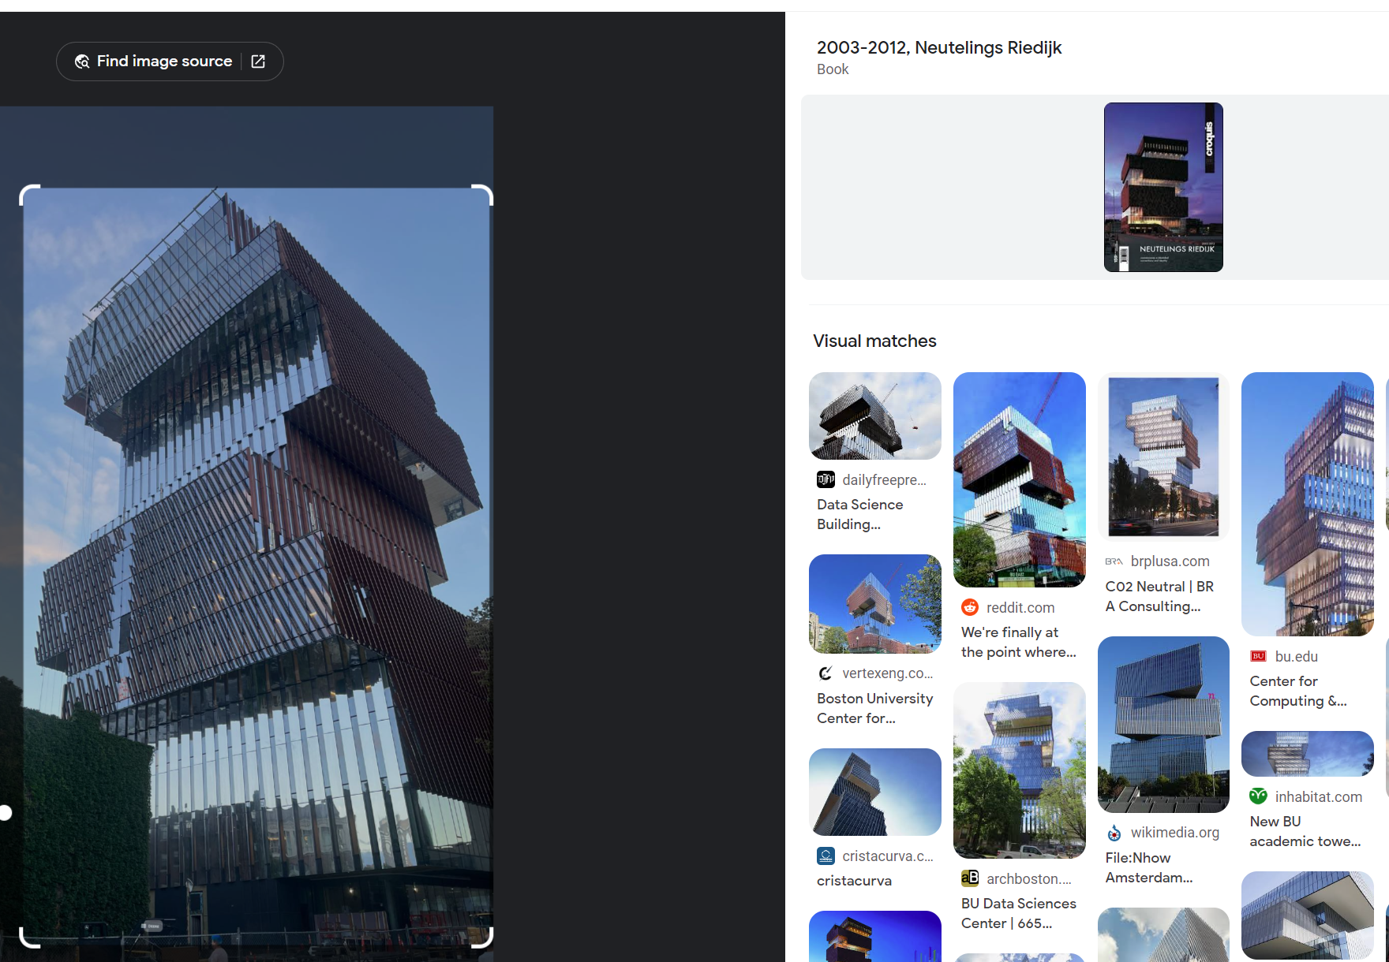
Google Images
https://images.google.com/
Center for Computing & Data Sciences

Slide 4
technical route
speech maker: shu yang

Slide 5

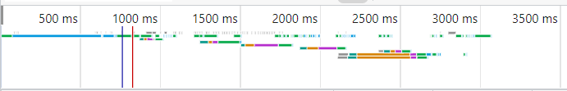
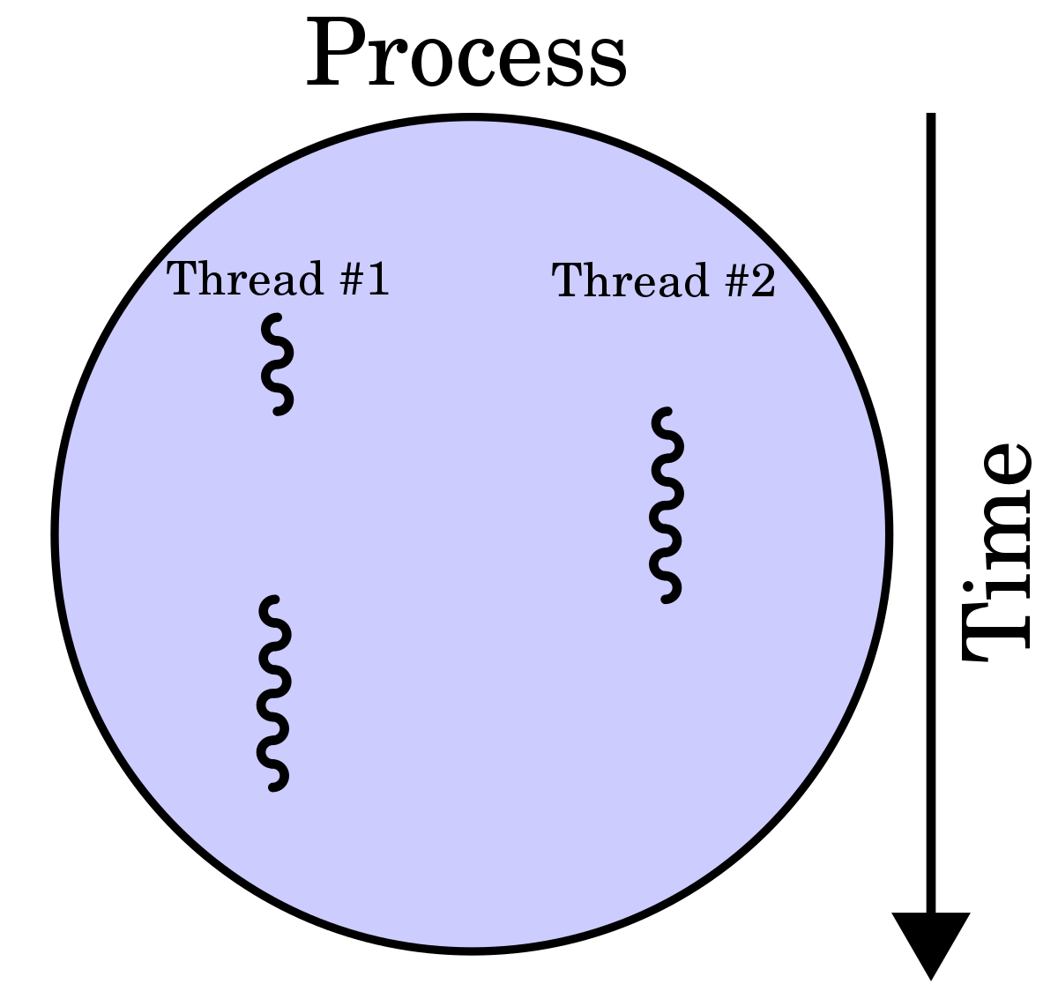

page searching
searching time
anti-anticrawler tech
act like a Chrome!
selenium
multiple thread

Slide 6
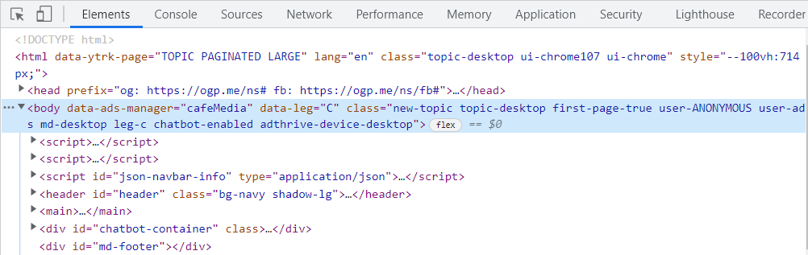
preprocess : key words extraction
disregrad the HTML language grammer part
pay attention only to the fruitful result part key words
neglect the meaningless words
code denoising
remove irrelavent key words
remove stop words

Slide 7
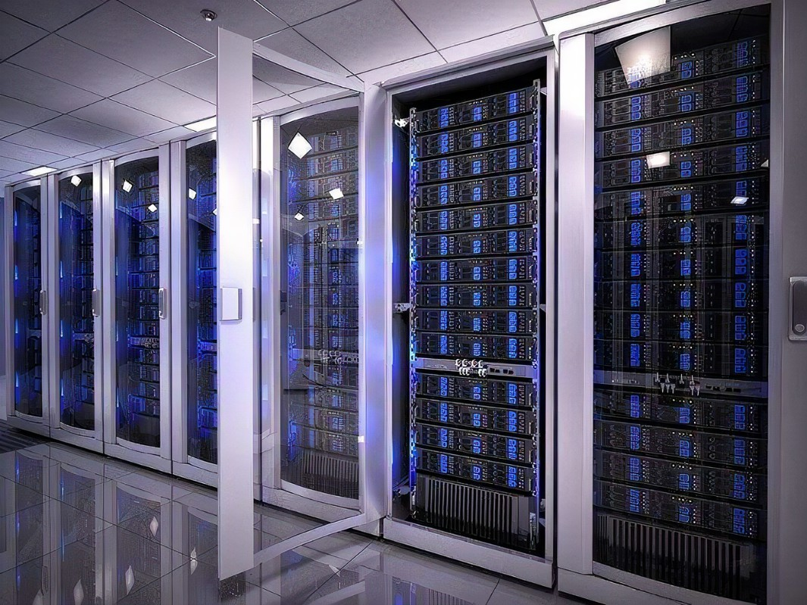

preprocess : data reforming
data saving
indexing
key word ranking

Slide 8
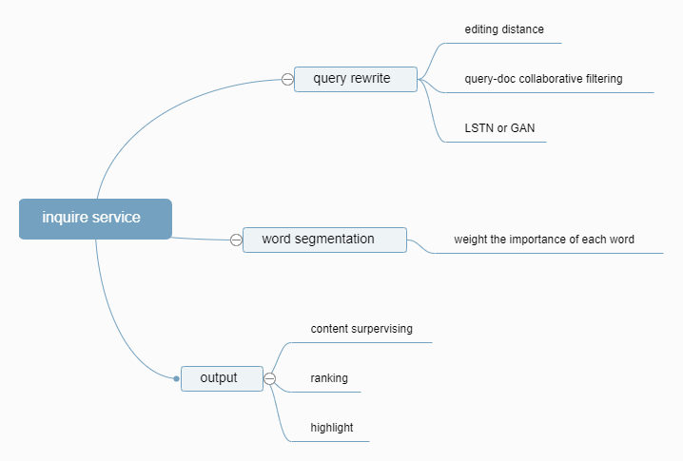
inquire service

Slide 9
Related Work

Slide 10
Large scale reverse image search
Gaillard, Mathieu, and Előd Egyed-Zsigmond. "Large scale reverse image search." XXXVème Congrès INFORSID (2017): 127
The author focused on finding similar images in an image collection with a very large scale. They applied a perceptual hash-based solution and testing the speed and the precision of several existing image features.

Slide 11
Perceptual hashing
A technical solution for reverse image search consists of an image representation and a distance measure between these representations.
A perceptual hash function is a type of hash function that has the property to be analogous if inputs are similar.
The perceptual hash function extracts some features of media objects that are invariant under slight modifications.

Slide 12
Evaluation of reverse image search
Bitirim, Yiltan, et al. "an Evaluation of reverse Image search performance of Google." 2020 IEEE 44th Annual Computers, Software, and Applications Conference (COMPSAC). IEEE, 2020.
The author investigates reverse image search performance of Google in terms of Average Precisions at various cut-off points. They picked data from five different categories: "Fashion", "Computer", "Home", "Sports", and "Toys".

Slide 13
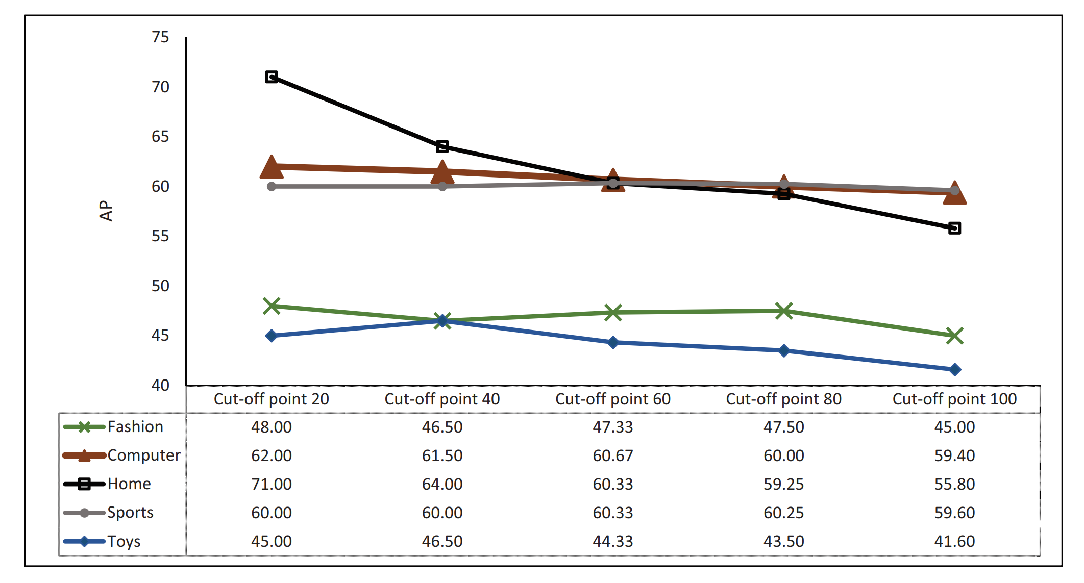
Result of evaluation
The search engine performance decrease with the increase of cut point.
Average precision at the cut-off points 20, 40, 60, 80, and 100

